Slide 1

Introduction to Acids & Bases
Is this your perception of acids & bases?
… some acids & bases can be like this, but most are not.

Slide 2
Colourful Chemistry of Acids and Bases (MIT)

Slide 3

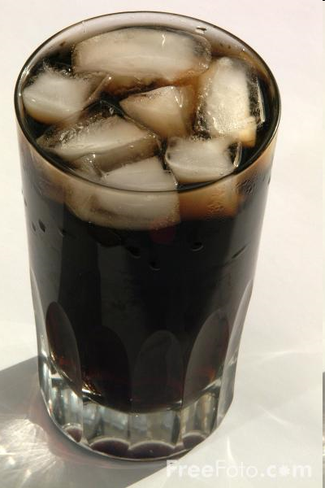
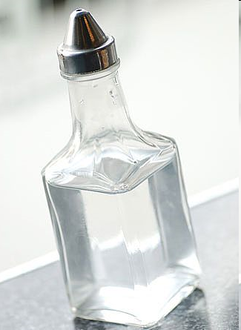
Common Acids
Citric
Acid
Carbonic
Acid
Acetic Acid
(Vinegar)
Substances that you use everyday
can be classified as acids
The opposite of an acid is a base. Example: Soaps
Note: Not all acids
are safe to eat!

Slide 4

What is an acid?
An acid is a compound that produces H⁺ ions when dissolved in water.
The symbol (aq)
means ‘aqueous’ or dissolved in water.

Slide 5
Ionization
Hydrogen chloride will ionize when dissolved in water:
HCl (aq) H⁺ (aq) + Cl ⁻ (aq)
When ions are in a solution, electricity can be conducted. (The solution is called an electrolyte)
HCl (aq) is called
hydrochloric acid
Acids produce H⁺ ions

Slide 6
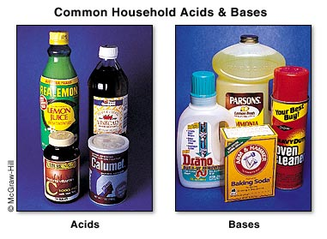
Common Bases
What is one
characteristic of bases?

Slide 7
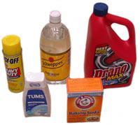
What is a base?
A base is a compound that produces hydroxide (OH)⁻ ions when dissolved in water.

Slide 8
Dissociation
Aqueous solutions of bases also contain ions and therefore conduct electricity.
NaOH(aq) Na⁺ (aq) + (OH)⁻ (aq)
Sodium
Hydroxide
(aq)
Aqueous
Sodium
Ion
Aqueous
Hydroxide
Ion

Slide 9
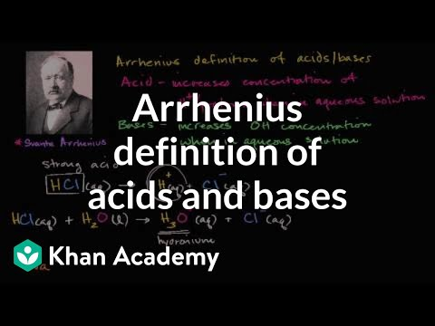

Slide 10
Properties Comparison
Property | Acids | Bases
Taste | Sour | bitter
Solubility | Soluble | soluble
Litmus paper result | AciDs turn blue litmus paper reD | Bases turn Red litmus paper Blue
Electrical | Good conductors Ionize to release H+ ions in water | Good conductors Ionize to release OH+ ions in water
Reactions | React with some metal to make H₂ | React with acids to make salt and water
Found in… | Salad dressings, citrus fruits, aspirin, some pops | Many cleaning products, soaps, baking soda
Formula | Begin with Hydrogen Ex. H₂SO₄ | Contain hydroxide or bicarbonate Ex NaOH

Slide 11
Naming Acids
1. Binary Acids
Composed of 2 elements: hydrogen and a non-metal
Start with ‘hydro’
End with ‘ic’
HF
Hydrofluoric
acid
HBr
Hydrobromic
acid
HI
Hydriodic
acid

Slide 12
Naming Acids
2. Oxoacids
Composed of hydrogen, oxygen, and another element
In general, they are a polyatomic group with a hydrogen cation
NOTE: You use ONLY the name of the polyatomic group and replace endings as below. NO hydro in the name of acids with polyatomic ions.
Replace ‘ate’ endings
with ‘ic acid’
Replace ‘ite’ endings
with ‘ous acid’
H₂SO₃
Sulfurous
acid
H₂SO₄
Sulfuric
acid
HNO₃
Nitric
acid
H₃PO₄
Phosphoric
acid

Slide 13
Naming Bases
Either have a common name or just use the standard ionic naming
NaOH
Sodium
hydroxide

Slide 14
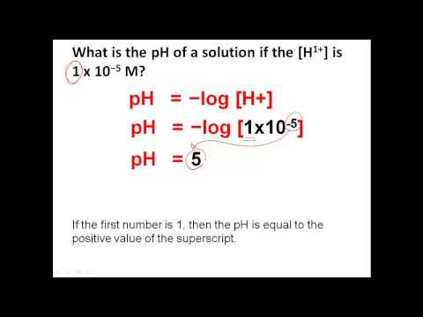

Slide 15
To determine [H+] when given pH, its just reversing the log:
[H+] = 10 ^{-pH}
NOTE that you need to put a negative in front of the pH in the exponent.

Slide 16


Slide 17
Strength & Weakness of acids & bases Ted-Ed

Slide 18
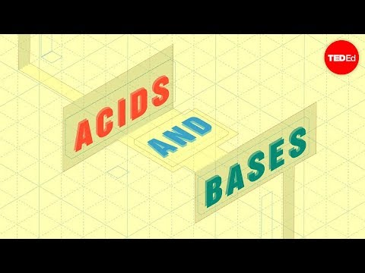

Slide 19


Slide 20

Acid/Base Name Game
Acid/Base
Name Lists:
p. 222, 223, & 226
Label names & formulas as follows …..

Slide 21
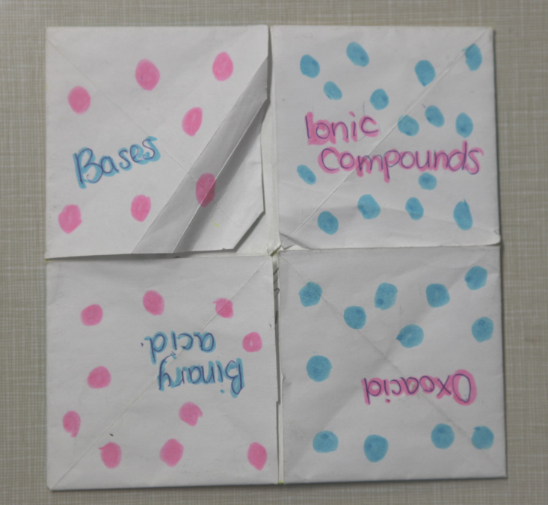
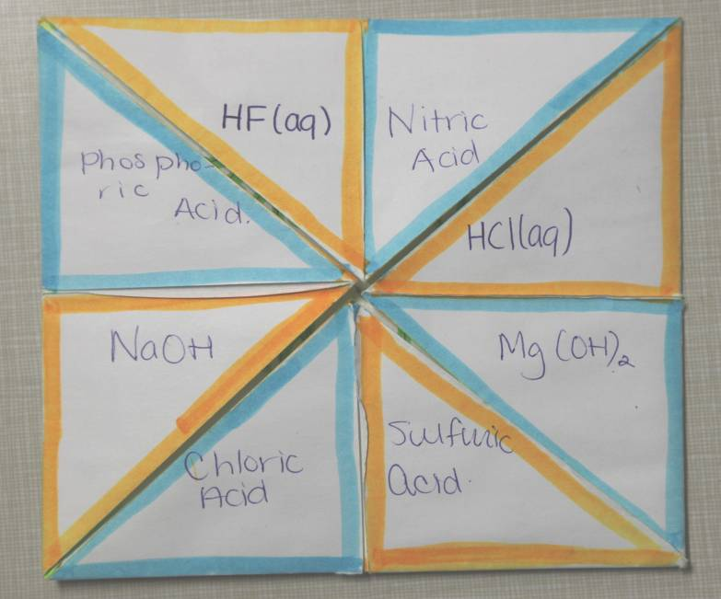
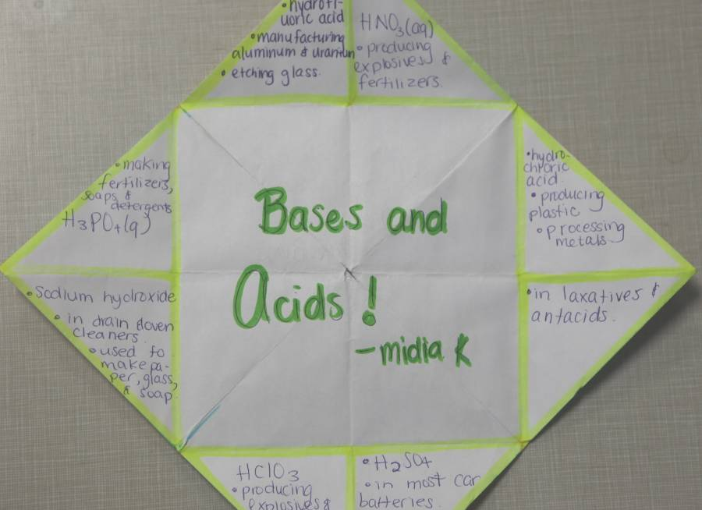
1. Place any 4 acid/base words
on the outside four ‘finger flaps’.
2. i) Choose any 4 acid/base formulas &
ii) Choose any 4 acid/base names …
and place them on the eight ‘inner flaps’.
3. Underneath each ‘inner flap’ place:
i) the name/formula answer;
ii) at least two different uses.
See pages
222 -226
4. Colour code and/or decorate
your acid/base ‘cootie catcher’.

